Slide 1
Roadmap to Continuous Integration Testing and Benefits Gowri Selka, Walgreens Natalie Koltun, Walgreens
WE HELP PEOPLE GET, STAY and LIVE WELL.
May 20th, 2014

Slide 2
What is Continues Integration? --Modified
Continuous integration (CI) is the practice of merging all developer working copies with a shared mainline , several times a day.
CI is used in combination with automated unit tests. Other activities that are usually done during this time are static and dynamic tests, performance profiling tests, extract ion and formation of documentation from the source code and facilitate manual QA processes.
This is a practice of test-driven development. Hence running all unit tests and verifying they all passed before committing to the mainline helps avoid one developer's work in progress breaking another developer's copy.
The Principles
When considering a move to Continuous Delivery, some basic software development process principles apply:
higher quality + automation(test + provisioning + deployment) =
cost reduction + acceleration

Slide 3
Why Continuous Integration?
Software development practice where discipline is set for frequent integration of work for better & quicker feedback on quality. CI is complemented by a QA process that is swift, robust and agile.
Always be aware of current status of the project
Less time spent investigating integration bugs
Less time wasted because of broken code in version control system
Prove your system can build!
Increase code quality with additional tasks
Discover potential deployment issues
Why Continuous Integration ?
Continuous Integration through tools driven automated build and test methodology, thereby making sure that changes to a software project’s code base are successfully built, tested, reported on, and rapidly made available to all parties after they are introduced.
Developer
Database
Commit Changes
Feedback Mechanism
Generate
Developer
Commit Changes
Build Server
Version Control Repository
Poll
Compile Source code
Integrate Database
Run Tests
Deploy Software
Test Developer
CI SERVER Integration
Build Machine
Automation Scripts
Commit Changes
Develop Scripts
Key Features
Build Automation | Build Integration | Test Automation | Automated Deployments | Report on the “Build”

Slide 4
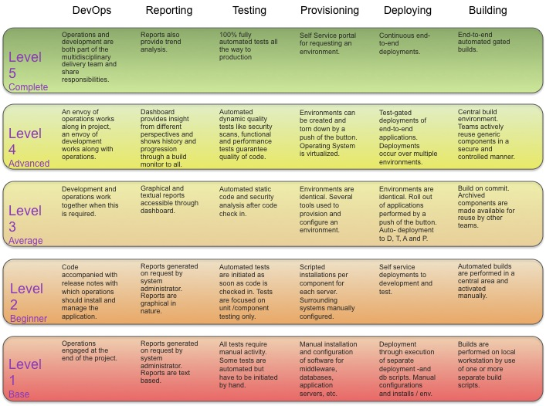
Maturity Model
White Paper: Introducing Continues Delivery in the Enterprise

Slide 5
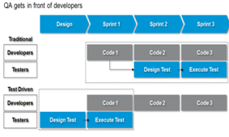
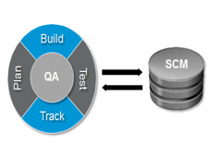
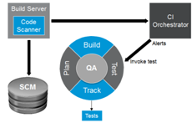
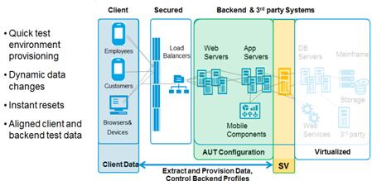
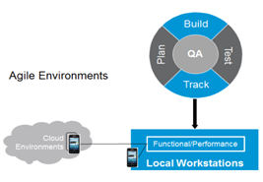
5 Key Imperatives for Continuous Integration
1
“Shift Left”
2
QA and Dev synchronization
3
Continuous Testing
4
Virtualization
5
Environments on Demand
5

Slide 6
Continues Integrated Testing Automation
Requirements Modeling and Automation
Early Automation
Tools based approach to modeling requirements as business process flows and activity diagrams
Plug and Play business process flows are available with mature organizations
Stubs and scripts made available for developers to quickly subject units for testing
Frameworks for continuous integration
Non-GUI Automation
Test Design Automation
SOA – Web Services Test Automation
Server side Automation
Message Validation
Batch automation
Automation for ETL layers
Integrated Automation
Automated generation of Test scenarios and Test cases for requirement models
Organization have accelerate testing cycles by as much as 50% by adopting design automation techniques
Non-Conventional Automation
Test Data Automation
Automation tools and plug-ins enabling quicker completion of non-value adding activities including result compilations, reporting and metrics management
Adoption of automation frameworks and tools for test data has enabled organizations to enhance testing results and reduce cost by over 33%
Regression Automation + Virtualization
Newer automation frameworks enabling parallel execution of automation scripts in available/virtualized environments thus accelerating cycles
6

Slide 7
`
CI – Implementation Benefits
Area | Description | Before Implementation | After CI Implementation | Savings
SOA (web services) Testing | Testing of individual components integrated with Non-AUT components | 0 Defects in DIT | 30% Defects in DIT | High
Component level performance profiling | Early performance testing involvement Identifying bottlenecks and resolving issues early in the lifecycle | No profiling | Costly SQLs, Slow running code are identified | High
Utilization of testing team members | Increased resources productivity, cross functioning and cross training Comprehensive understanding of backend and frontend components | Significant time spent waiting for env to be perfect | Test teams are 90% productive | High
Other Benefits:
Provide 24x7 access to backend systems eliminating downtime in all phases of the SDLC
Reduce data management challenges by giving Dev and QA teams complete data control without the need to rely on other teams, allowing for parallel testing
Perform more flexible testing (Negative or Edge Case Scenarios)
Enable more comprehensive service level test coverage (prior to UI testing) fostering shift-left initiative
Enhanced automated and performance testing coverage across releases and off cycle initiatives
Improving SDLC methodology to achieve higher agility, delivering faster time to market meeting business demand

Slide 8
Getting Started
Assessment
Engage the development team
Implement and align tools & processes
Formalize the environment
Achieve Continuous Delivery

Slide 9
Thank You

